Slide 1
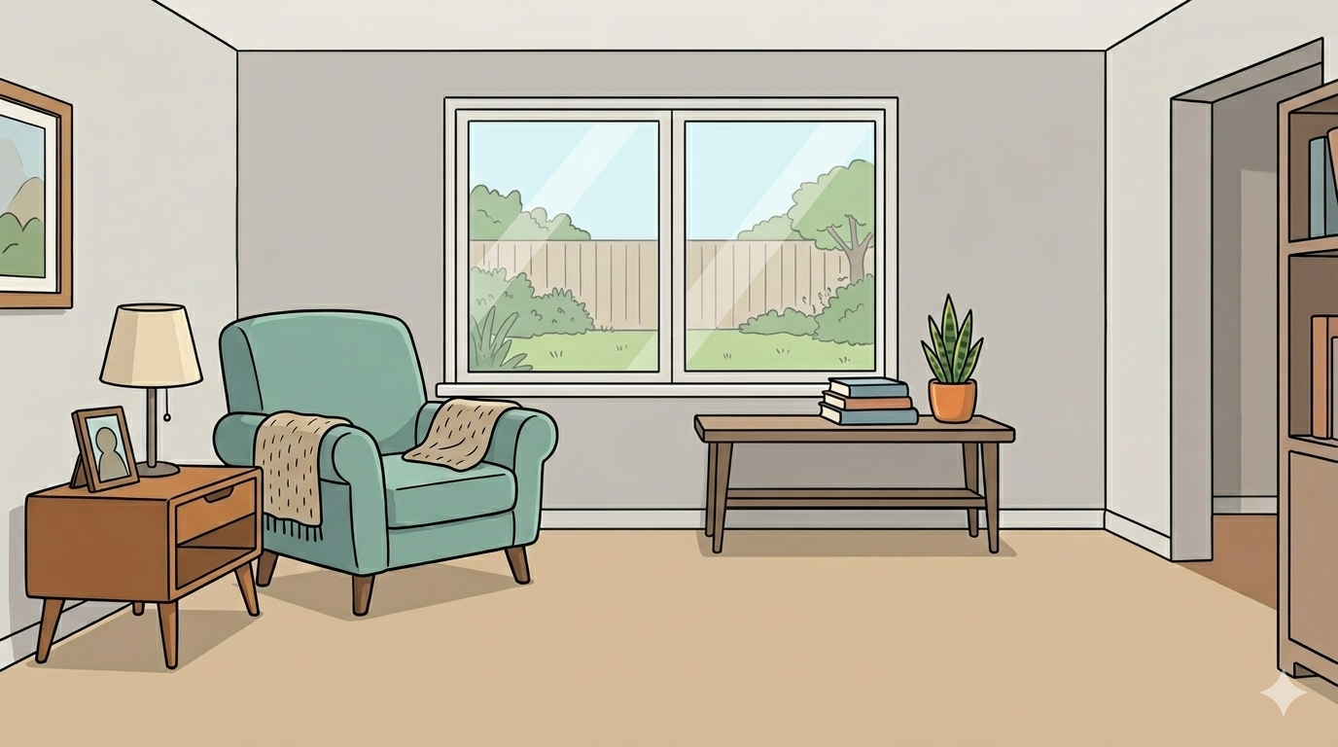
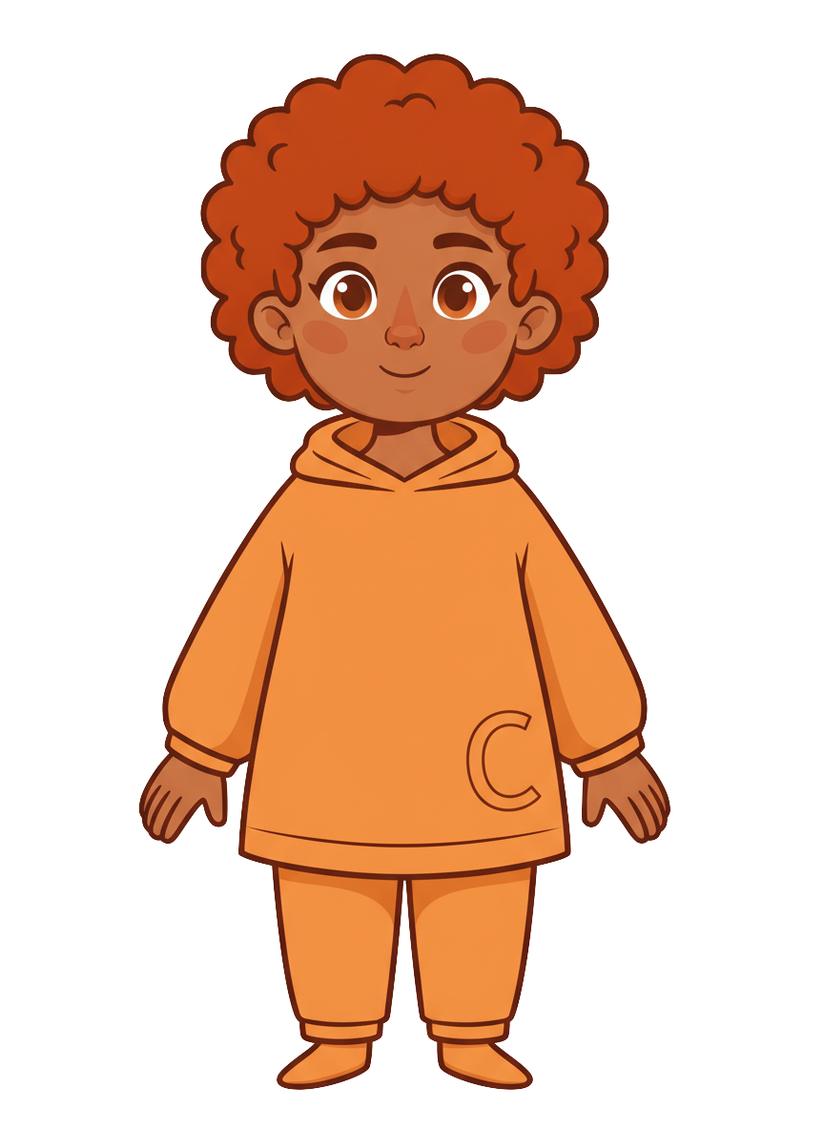
This is Finn

Slide 2

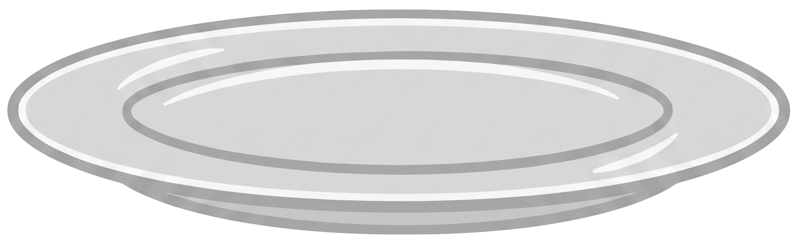
Finn has 5 cookies

Slide 3
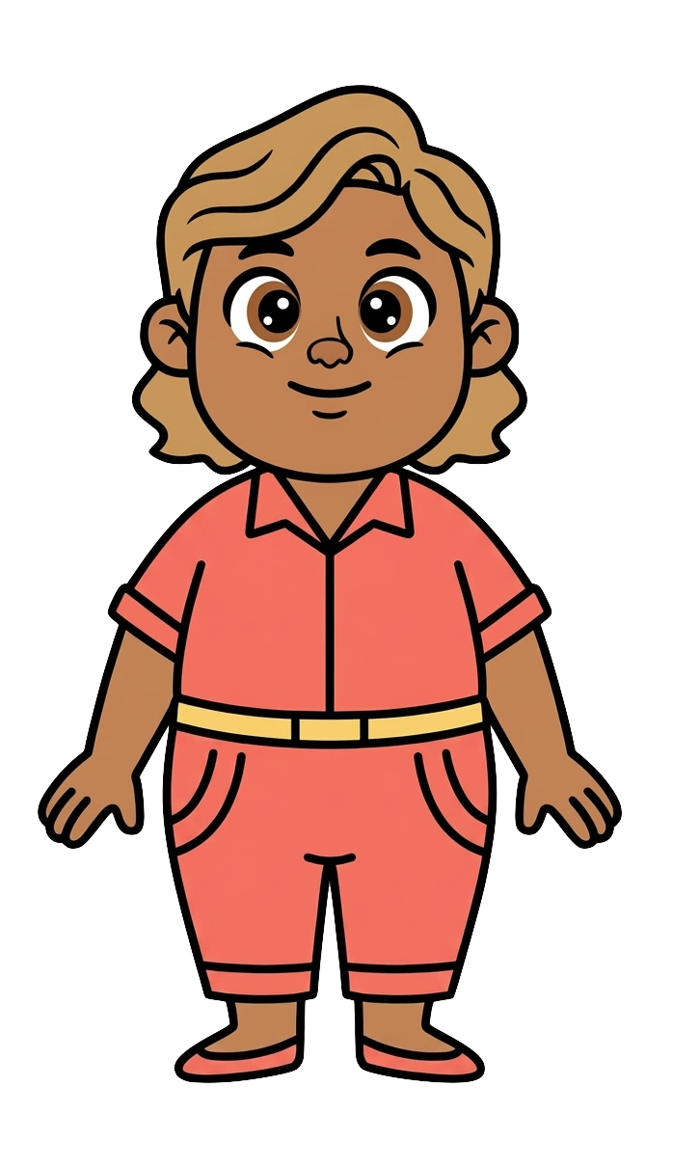
This is Cleo

Slide 4
Cleo has 4 cookies

Slide 5
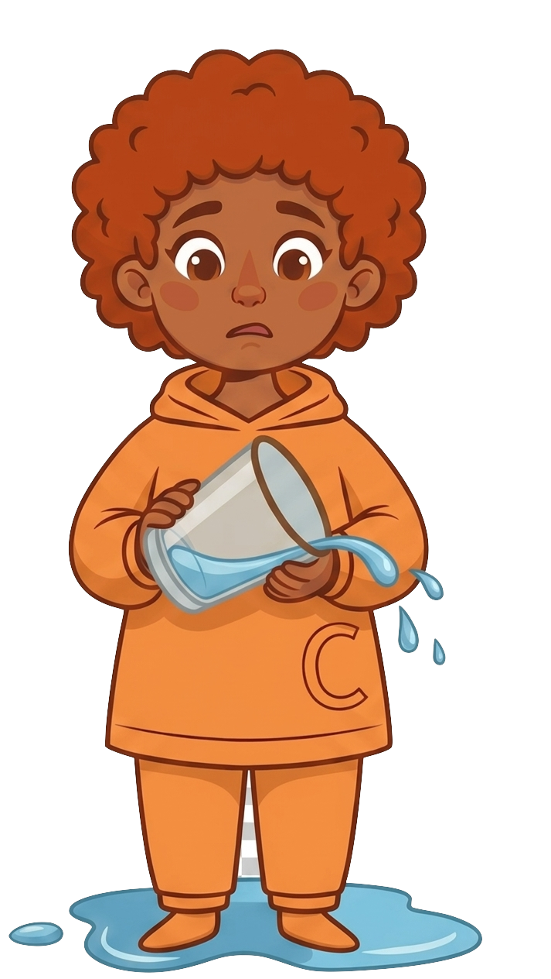
Finn spills water

Slide 6
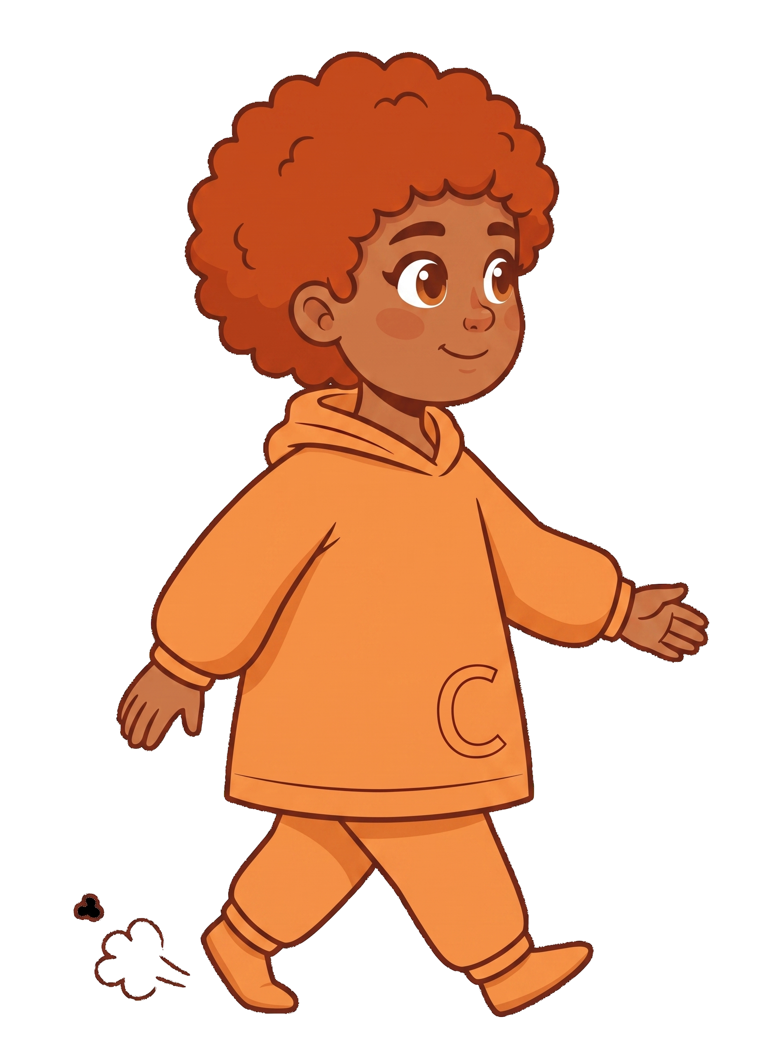
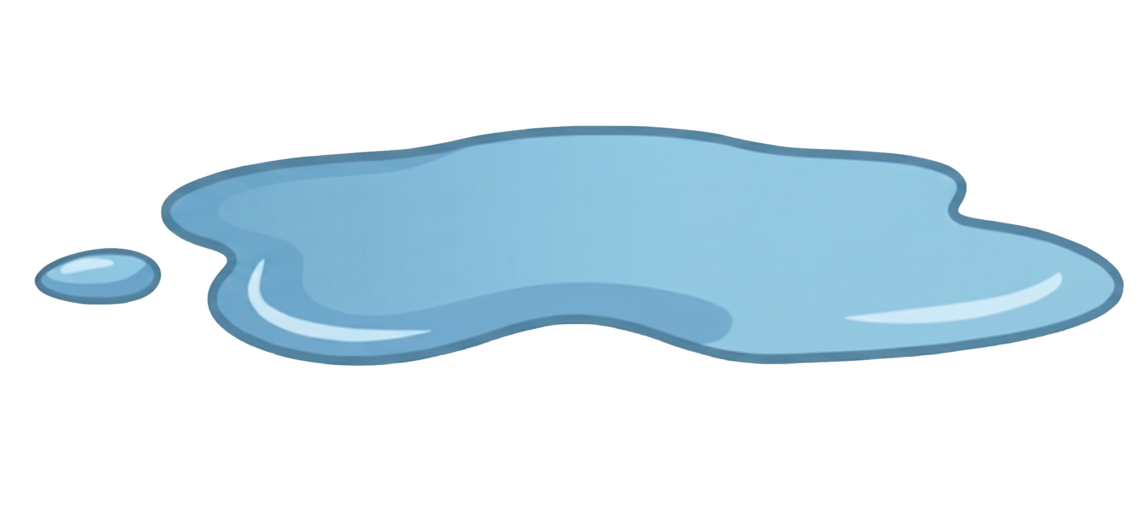
Finn doesn’t clean it up and walked away

Slide 7
Finn doesn’t clean it up and walked away

Slide 8
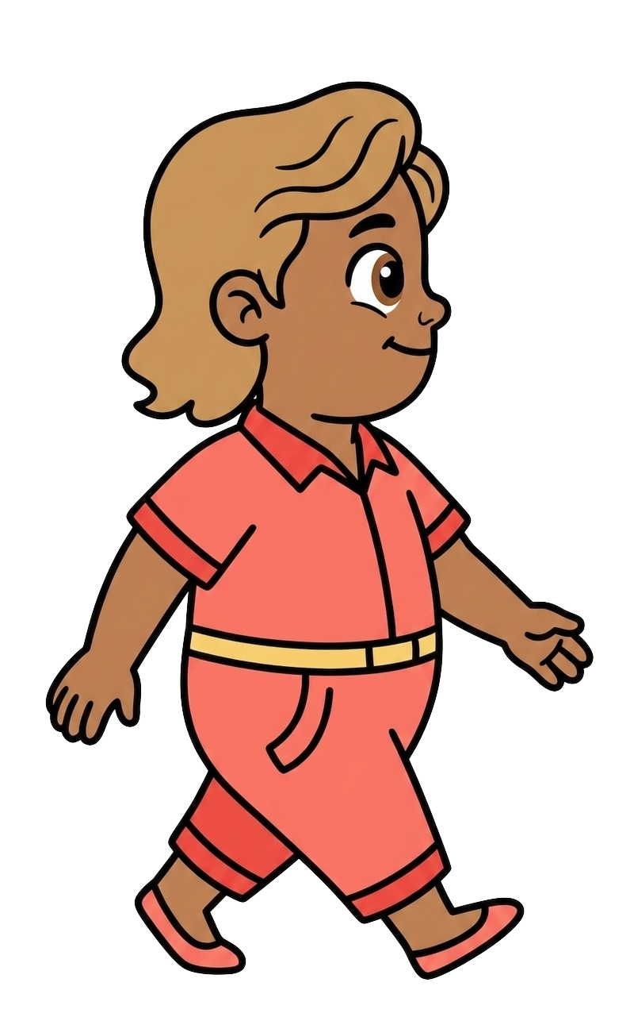
Cleo walks in

Slide 9
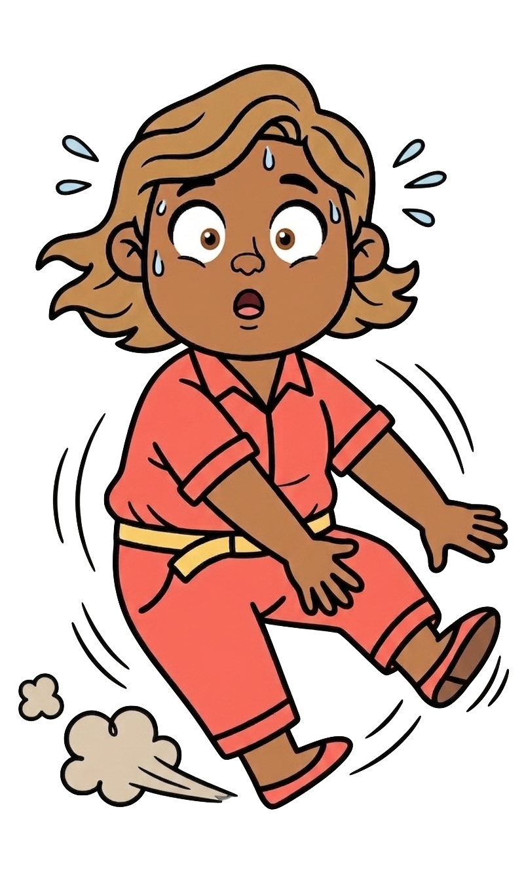
Oh no! Cleo slipped on the water!

Slide 10
2 of Cleo’s cookies fell!

Slide 11
Finn still has 5 cookies. Cleo now has 2 cookies.

Slide 12
Please decide whether you would like to move some of Finn’s cookies.

